Slide 1

VOLVOX
Scalable consensus solutions for emerging economies
Notes:
Positioning/Formatting of the message

Slide 2
VOLVOX
Corporate Presentation Deck

Slide 3

01 | Why we do what we do
02 | An opportunity for growth
03 | What we’re working on
04 | Who we are
05 | The future
Table of
Contents
Don’t worry – it’s not a lot

Slide 4
AGENDA
01 | Why we do what we do | 06 | This is content item 1 This is the subtitle
02 | An opportunity for growth | 07 | This is content item 1 This is the subtitle
03 | What we’re working on | 08 | This is content item 1 This is the subtitle
04 | Who we are | 09 | This is content item 1 This is the subtitle
05 | This is content item 1 This is the subtitle | 10 | This is content item 1 This is the subtitle

Slide 5

WHAT WE DO
Scalable consensus solutions for emerging markets

Slide 6


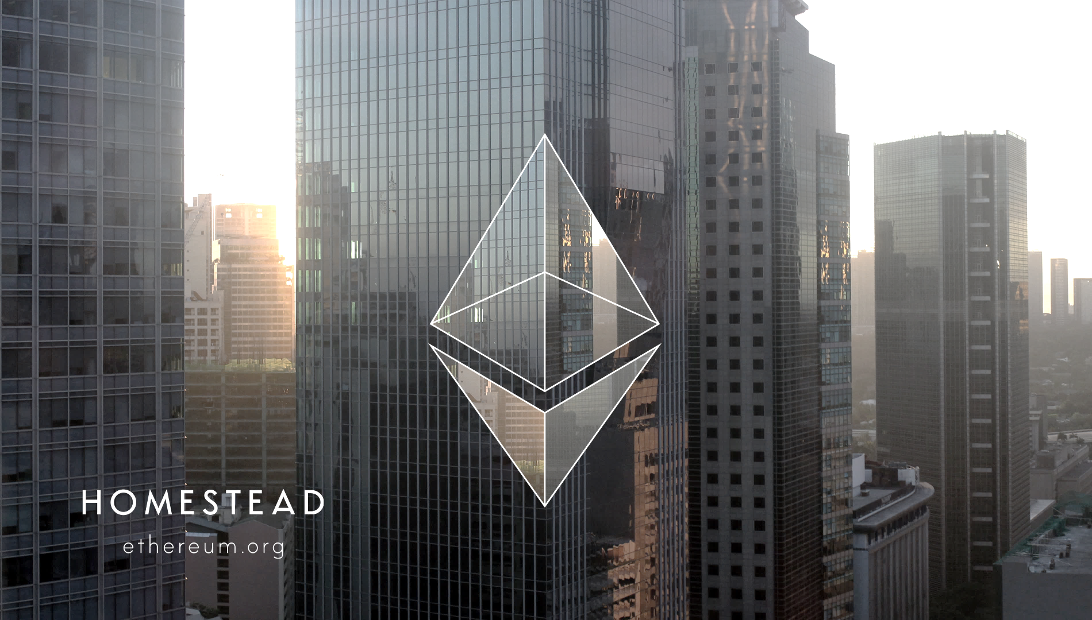


WHY WE DO WHAT WE DO
Increasing interest
in Blockchain technology
A New Era of Computation
Flexible and Dynamic Growth
Decentralized Systems allow for the creation of large tradeable trustless systems
The flexibility of the blockchain allows systems to quickly scale in a way that has not been possible until now

Slide 7

Bitcoin in Numbers
42B
4000
3200
99
MARKET CAP IN USD
USD / BTC
GRAPHIC DESIGN
VIDEO
Blockchain technologies are one of the fastest growing deep-tech platforms today, and are poised to be the new financial platform for the future.

Slide 9
GROWTH IN CRYPTOCURRENCY MARKET
ww

Slide 10
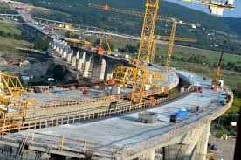
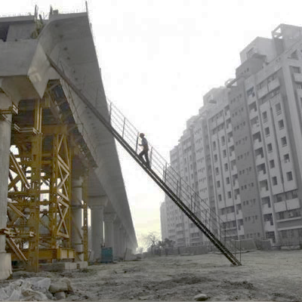
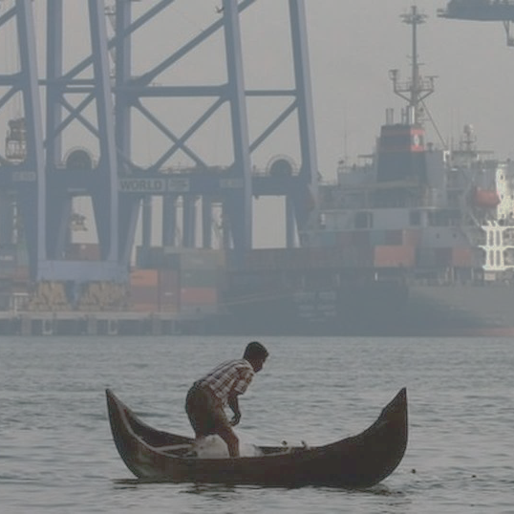
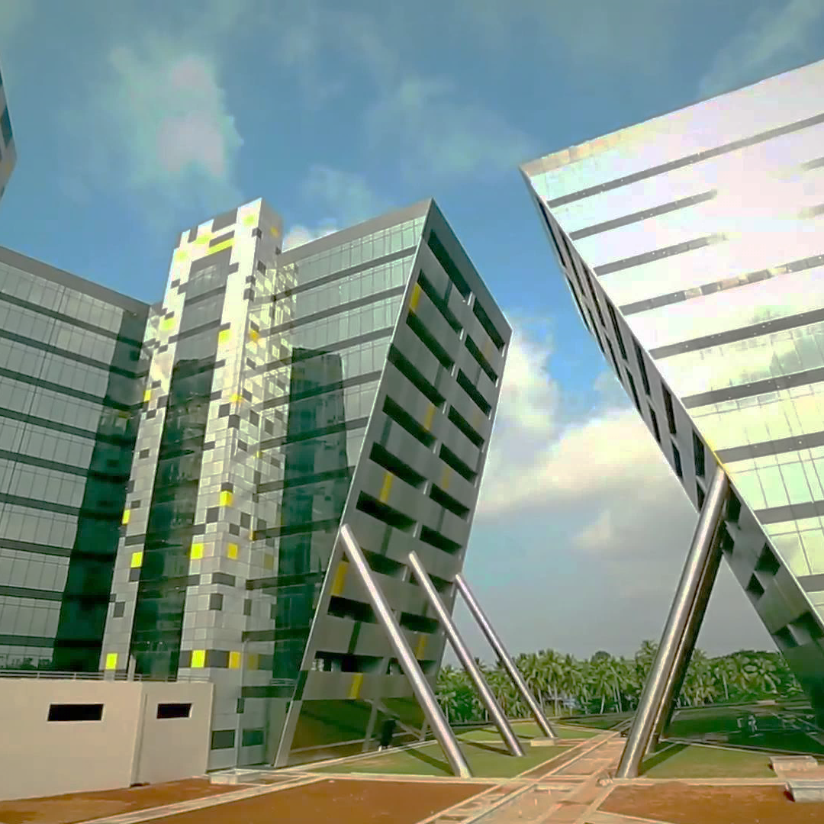
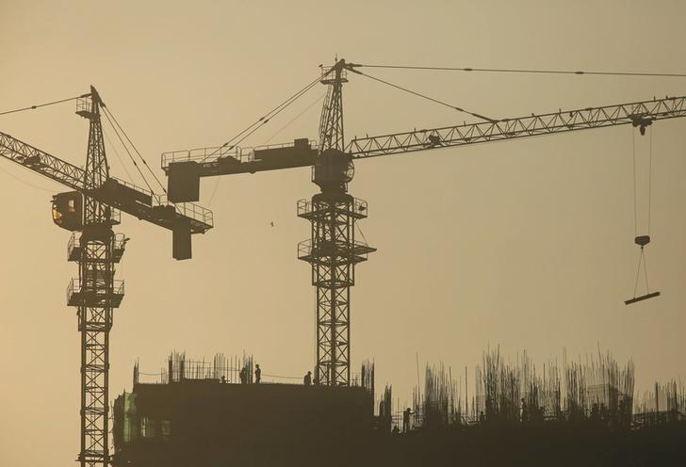
WHY WE DO WHAT WE DO
Growth in Emerging Markets
Infinite Opportunities
Expansive Growth
Deep Consumer Base
Replicability across industries
Large number of untapped markers
Scalability through technology
Decentralized markets allowing for non-traditional growth verticals

Slide 11
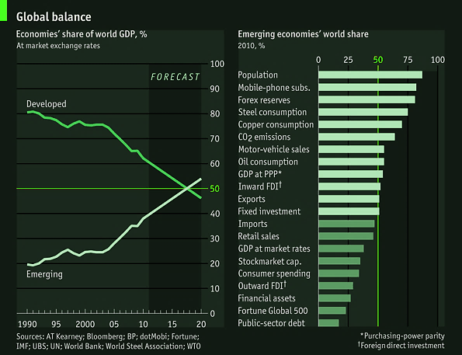
THE EMERGING MARKET
Increasing disposable income across consumers
Difficult to conquer through traditional infrastructure due to overhead
Blockchain technology allows for easy market growth with larger margins

Slide 12
Russia
39%
Saudi Arabia
China
73%
9%
Mexico
Malaysia
21%
Brazil
India
73%
82%
Thailand
9%
Nigeria
9%
12%
Indonesia
27%
South
Africa
39%
Source: Global Intelligence Alliance, Business Perspectives on Emerging Markets 2012-2017 Survey,
Qn: Which are the top 5 Emerging Markets for your industry over the next 5 years? N=34

Slide 13

OUR VISION
To play a key and structural role in the development of blockchain technologies by leaving our footprint on the emerging industries for decades to come – through industry-driven, market leading IP.

Slide 14



WHERE WE OPERATE
INSURANCE
Building a new framework for managing risk by restructuring and realigning incentives for all stakeholders involved.
FINANCIAL INSTRUMENTS
Some details
SUPPLY CHAIN MANAGEMENT
Some details
Intersection of decentralized economics and high-scale applications
LOGIC CONSENSUS
Some details

Slide 15
PROJECTS

Slide 16

PROJECTS
SAME SECURITY
The cross-chain database has the same security guarantees as public blockchains
1000x TRANSACTIONS
Multiple networks with focused transactions allows the network to grow faster
LARGER DATA VOLUMES
Multiple chains allows the system to scale, allowing the system to handle larger volumes
PUBLIC/PRIVATE HYBRID
Best of both private and public blockchains, developed at Volvox.
Inter-Ledger
Network
The Inter-Ledger network uses a public notarized cross-chain database, combining the best of private data-bases with the public blockchain

Slide 17



Connected to multiple public blockchains
Regular private blockchain

Slide 18
Multiple private blockchains Each capable of focusing on a specific task in a larger environment
Blockchains working on the same protocol
Allowing them to communicate with each other

Slide 19
Multiple private blockchains Each capable of focusing on a specific task in a larger environment
Blockchains working on the same protocol
Allowing them to communicate with each other

Slide 20
Inter-Blockchain Layer

Slide 21
ASSETS
Capital
Encapsulated Assets
Algorithms (Ex & Non-Ex)
Digital ↔ Digital
INTER-LEDGER
NETWORK
INTERFACES
LEDGER
PARTIES
Digital ↔ Real
Partied
Non-partied
Digital ↔ Digital
Transactional
Ownership
Permission
Recording
Players
Regulator
Investor
Algorithms
Oracles
Contracts/DAO
Network Protocol
Sharding
Inter-Ledger consensus
CONTRACTS

Slide 22

PROJECTS
TRULY PEER-TO-PEER
Truly scalable and replicating models for direct C2C interaction.
ASSURED LIQUIDITY
Guaranteed liquidity provided by dynamically scaling market infrastructure
DISTRIBUTED CLAIMS
Bespoke claims processing framework allows for individual to corporate level insurance across verticals
DERIVATIVES MARKET
Secondary trading markets allow for cash inflow from larger economies
REX
Decentralized Risk Exchange for a peer-to-peer insurance system

Slide 23

PROJECTS
FORMAL VERIFICATION
Mathematically verified contracts ensure long-term viability
SAFER CONTRACTS
Safer architecture reduces occurrence of bugs in code, increasing trust
PROPRIETARY TECHNOLOGY
Allows for Volvox chains to possess an edge over existing infrastuctures
Logic Smart
Contracts
Pioneering safer smart contract architectures for purely digital organizations

Slide 24
THE TEAM

Slide 25
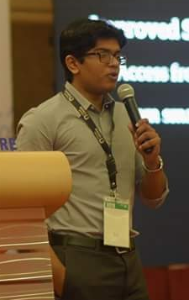
HRISHI OLICKEL
CHIEF EXECUTIVE OFFICER
Developer of Oyente – Smart Contract Verification tool, now part of the Ethereum blockchain
Previously CTO of > $300 million Malaysian gold-blockchain firm DinarDirham
Chief Developer at Anquan Capital, with experience in developing fintech solutions for the Singapore Government
Over three years of research experience in deep-technology sector

Slide 26

The Team
JAYDEV SREEVALLABHAN
CHIEF FINANCIAL OFFICER
Over 5 years in Insurance at the helm of one of the biggest insurance brokers in the state of Kerala
Mini coy islands project - planning and implementing the entire water supply pipeline backbone of the island
Negotiated and finalized engineering claims over 2 million USD
Overseeing implementation of insurance programs covering over 1,60,000 beneficiaries

Slide 27

The Team
PARAG BHATNAGAR
CHIEF DESIGN OFFICER
4 years of User Interface and User Experience development for web applications and interfaces
4 years in brand design and corporate identity design
Full-stack Engineer, focused on Front-End development
Worked as engineer for financial tech in emerging markets for 1 year

Slide 28
FIN

Slide 29

Undertaking the quest to build digital highways for the next billion

Slide 30



Insert some info in this particular section or try a quote or something

Slide 31

SLIDE IDEA
FOCUS ON IMAGE

Slide 32
THREE THINGS
Thing 1
Thing 2
Thing 3

Slide 33
PALETTE
TITLE FONT
GOTHAM BLACK
HEADING FONT RALEWAY
Body Font Raleway ExtraLight

